Slide 1
Head to the Moon … Always … Because when you fall you shall fall among the Stars.
Attriqah Secondary School
Nahid al-Sha’shai

Slide 2
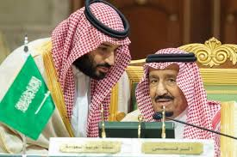
a Saudi agency established by a royal order on December 27, 2018. The agency is chaired by Sultan bin Salman, who flew aboard the U.S. Space Shuttle Discovery in the 1980s as the first Arab in space

Slide 3
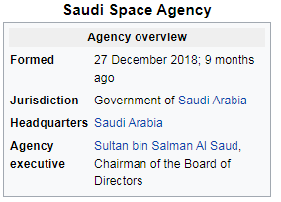
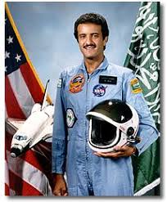

Slide 4
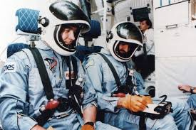
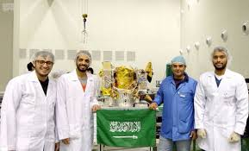

Slide 5
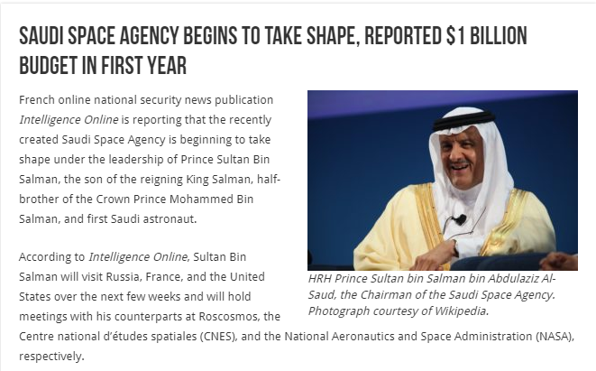

Slide 6
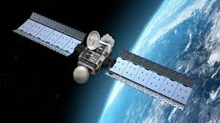
Space Week
7th October – 11October

